Slide 1
Recursion
Chapter 7

Slide 2
Chapter Objectives
To understand how to think recursively
To learn how to trace a recursive function
To learn how to write recursive algorithms and functions for searching vectors
To understand how to use recursion to solve the Towers of Hanoi problem
To understand how to use recursion to process two-dimensional images
To learn how to apply backtracking to solve search problems such as finding a path through a maze

Slide 3
Recursion
Recursion can solve many programming problems that are difficult to conceptualize and solve linearly
In the field of artificial intelligence, recursion often is used to write programs that exhibit intelligent behavior:
playing games of chess
proving mathematical theorems
recognizing patterns, and so on
Recursive algorithms can
compute factorials
compute a greatest common divisor
process data structures (strings, vectors, linked lists, etc.)
search efficiently using a binary search
find a path through a maze, and more

Slide 4
Recursive Thinking
Section 7.1

Slide 5
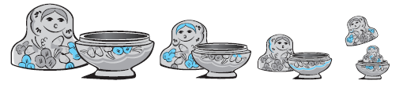
Recursive Thinking
Recursion is a problem-solving approach that can be used to generate simple solutions to certain kinds of problems that are difficult to solve by other means
Recursion reduces a problem into one or more simpler versions of itself

Slide 6
Recursive Thinking (cont.)
Recursive Algorithm to Process Nested Figures
if there is one figure in the nest
Do whatever is required to the figure
else
Do whatever is required to the outer figure in the nest
Process the nest of figures inside the outer figure in the same way

Slide 7
Recursive Thinking (cont.)
Consider searching for a target value in an vector
Assume the vector elements are sorted in increasing order
We compare the target to the middle element and, if the middle element does not match the target, search either the elements before the middle element or the elements after the middle element
Instead of searching n elements, we search n/2 elements

Slide 8
Recursive Thinking (cont.)
Recursive Algorithm to Search an vector
if the vector is empty
Return -1 as the search result
else if the middle element matches the target
Return the subscript of the middle element as the result
else if the target is less than the middle element
Recursively search the vector elements preceding the middle element and return the result
else
Recursively search the vector elements following the middle element and return the result

Slide 9
Recursive Thinking (cont.)
General Recursive Algorithm
if the problem can be solved directly for the current value of n
Solve it
else
Recursively apply the algorithm to one or more problems involving smaller values of n
Combine the solutions to the smaller problems to get the solution to the original problem

Slide 10
Recursive Thinking (cont.)
General Recursive Algorithm
if the problem can be solved directly for the current value of n
Solve it
else
Recursively apply the algorithm to one or more problems involving smaller values of n
Combine the solutions to the smaller problems to get the solution to the original problem
Step 1 involves a test for what is called the base case: a value of n for which the problem can be solved easily

Slide 11
Recursive Thinking (cont.)
General Recursive Algorithm
if the problem can be solved directly for the current value of n
Solve it
else
Recursively apply the algorithm to one or more problems involving smaller values of n
Combine the solutions to the smaller problems to get the solution to the original problem
Step 3 is the recursive case, because there we recursively apply the algorithm

Slide 12
Recursive Thinking (cont.)
General Recursive Algorithm
if the problem can be solved directly for the current value of n
Solve it
else
Recursively apply the algorithm to one or more problems involving smaller values of n
Combine the solutions to the smaller problems to get the solution to the original problem
Because the value of n for each recursive case is smaller than the original value of n, each recursive case makes progress towards a base case

Slide 13
Recursive Thinking (cont.)
General Recursive Algorithm
if the problem can be solved directly for the current value of n
Solve it
else
Recursively apply the algorithm to one or more problems involving smaller values of n
Combine the solutions to the smaller problems to get the solution to the original problem
Whenever a split occurs, we revisit Step 1 for each new problem to see whether it is a base case or a recursive case

Slide 14
Steps to Design a Recursive Algorithm
Summary of characteristics:
There must be at least one case (the base case), typically for a small value of n, that can be solved directly
A problem of a given size n can be reduced to one or more smaller versions of the same problem (the recursive case)
Design:
Recognize a base case and provide a solution to it
Devise a strategy to split the problem into smaller versions of itself while making progress toward a base case
Combine the solutions to the smaller problems to solve the larger problem

Slide 15
Recursive Algorithm for Finding the Length of a String
if the string is empty (has no characters)
The length is 0
else
The length is 1 plus the length of the string that excludes the first character

Slide 16
Recursive Algorithm for Finding the Length of a String (cont.)
/** Recursive function size
@param str The string
@return The length of the string
*/
int size(string str) {
if (str == "")
return 0;
else
return 1 + size(str.substr(1));
}

Slide 17
Recursive Algorithm for Printing String Characters
/** Recursive function print_chars
post: The argument string is displayed, one character per line
@param str The string
*/
void print_chars(string str) {
if (str == "") {
return;
} else {
cout << str.at(0) << endl;
print_chars(str.substr(1));
}
}

Slide 18
Recursive Algorithm for Printing String Characters in Reverse Order
/** Recursive function print_chars_reverse
post: The argument string is displayed in reverse order, one character per line
@param str The string
*/
void print_chars_reverse(string str) {
if (str == "") {
return;
} else {
print_chars_reverse(str.substr(1));
cout << str.at(0) << endl;
}
}

Slide 19
Proving that a Recursive Function is Correct
Proof by induction
Prove the theorem is true for a base case of (usually) n = 0 or n = 1
Show that if the theorem is assumed true for k, then it must be true for k+1
Recursive proof is similar to induction
Verify a base case is recognized and solved correctly
Verify that each recursive case makes progress towards a base case; that is, any new problems generated are smaller versions of the original problem.
Verify that if all smaller problems are solved correctly, then the original problem also is solved correctly

Slide 20
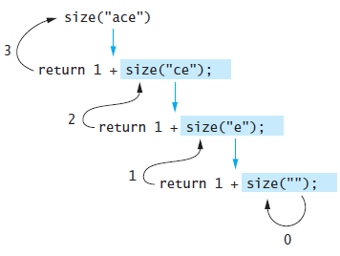
Tracing a Recursive Function
The process of returning from recursive calls and computing the partial results is called unwinding the recursion

Slide 21
The Stack and Activation Frames
C++ maintains a stack on which it saves new information in the form of an activation frame
The activation frame contains storage for
function arguments
local variables (if any)
the return address of the instruction that called the function
Whenever a new function is called (recursive or otherwise), C++ pushes a new activation frame onto the stack

Slide 22
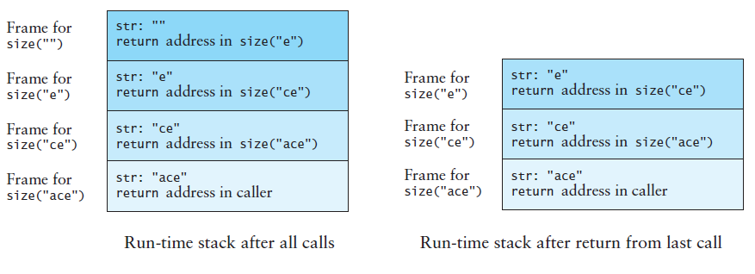
Run-Time Stack and Activation Frames (cont.)

Slide 23
Analogy for the Run-Time Stack for Recursive Calls
An office tower has an employee on each level each with the same list of instructions
The employee on the bottom level carries out part of the instructions, calls the employee on the next level up and is put on hold
The employee on the next level completes part of the instructions and calls the employee on the next level up and is put on hold
The employee on the next level completes part of the instructions and calls the employee on the next level up and is put on hold
The employee on the next level completes part of the instructions and calls the employee on the next level up and is put on hold, an so on until the top level is reached

Slide 24
Analogy for the Run-Time Stack for Recursive Calls (cont.)
When the employee on the top level finishes the instructions, that employee returns an answer to the employee below
The employee below resumes, and when finished, returns an answer to the employee below
The employee below resumes, and when finished, returns an answer to the employee below
The employee below resumes, and when finished, returns an answer to the employee below, and so on
Eventually the bottom is reached, and all instructions are executed

Slide 25
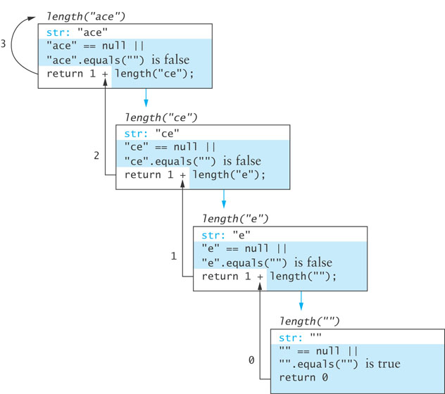
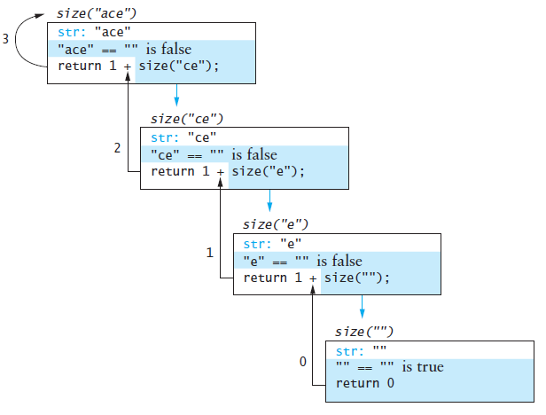
Run-Time Stack and Activation Frames

Slide 26
Recursive Definitions of Mathematical Formulas
Section 7.2

Slide 27
Recursive Definitions of Mathematical Formulas
Mathematicians often use recursive definitions of formulas that lead naturally to recursive algorithms
Examples include:
factorials
powers
greatest common divisors (gcd)

Slide 28
Factorial of n: n!

Slide 29
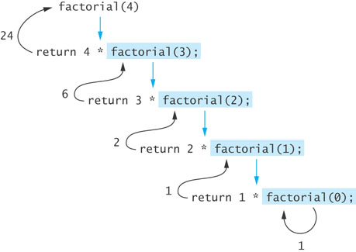
Factorial of n: n! (cont.)
The recursive definition can be expressed by the following algorithm:
if n equals 0
n! is 1
else
n! = n x (n – 1)!
The last step can be implemented as:
return n * factorial(n – 1);

Slide 30
Factorial of n: n! (cont.)
int factorial(int n) {
if (n == 0)
return 1;
else
return n * factorial(n – 1);
}

Slide 31
Infinite Recursion and Stack Overflow
If you call function factorial with a negative argument, the recursion will not terminate properly because n will never equal 0
Make sure your recursive functions are constructed so that an appropriate stopping case is always reached
In the factorial function, you could throw an invalid_argument exception if n is negative
If your program does not terminate properly, you will eventually get a run-time error when there is no more memory available for your program to execute more function calls

Slide 32
Recursive Algorithm for Calculating x^{n}

Slide 33
Recursive Algorithm for Calculating x^{n} (cont.)

Slide 34
Recursive Algorithm for Calculating x^{n} (cont.)
/** Recursive power function
@param x The number being raised to a power
@param n The exponent
@return x raised to the power n
*/
double power(double x, int n) {
if (n == 0)
return 1;
else if (n > 0)
return x * power(x, n – 1);
else
return 1.0 / power(x, -n);
}

Slide 35
Recursive Algorithm for Calculating gcd
The greatest common divisor (gcd) of two numbers is the largest integer that divides both numbers
The gcd of 20 and 15 is 5
The gcd of 36 and 24 is 12
The gcd of 38 and 18 is 2
The gcd of 17 and 97 is 1

Slide 36
Recursive Algorithm for Calculating gcd (cont.)
Given two positive integers m and n (m > n)
if n is a divisor of m
gcd(m, n) = n
else
gcd (m, n) = gcd (n, m % n)

Slide 37
Recursive Algorithm for Calculating gcd (cont.)
Given two positive integers m and n (m > n)
if n is a divisor of m
The result is n
else
The result is gcd (n, m % n)

Slide 38
Recursive Algorithm for Calculating gcd (cont.)
How do we verify that our algorithm is correct?
Base case correct?
The base case is “n is a divisor of m”
The solution is n (n is the greatest common divisor), which is correct
Does recursion make progress to base case?
Both arguments in each recursive call are smaller than in the previous call and
The new second argument is always smaller than the new first argument (m % n must be less than n)
Eventually a divisor will be found or the second argument will become 1 (which is a base case because it divides every integer)

Slide 39
Recursive Algorithm for Calculating gcd (cont.)
/** Recursive gcd function
pre: m > 0 and n > 0
@param m The larger number
@param n The smaller number
@return Greatest common divisor of m and n
*/
int gcd(int m, int n) {
if (m % n == 0)
return n;
else if (m < n)
return gcd(n, m); // Transpose arguments
else
return gcd(n, m % n);
}

Slide 40
Recursion Versus Iteration
There are similarities between recursion and iteration
In iteration, a loop repetition condition determines whether to repeat the loop body or exit from the loop
In recursion, the condition usually tests for a base case
There is always an iterative solution to a problem that is solvable by recursion
A recursive algorithm may be simpler than an iterative algorithm and thus easier to write, code, debug, and read

Slide 41
Tail Recursion or Last-Line Recursion
Most of the recursive algorithms and functions you have seen so far are examples of tail recursion or last-line recursion
In these algorithms, there is a single recursive call and it is the last line of the function, such as in the factorial function:
int factorial(int n) {
if (n == 0)
return 1;
else
return n * factorial(n – 1);
}
It is a straightforward process to turn such a function into an iterative one

Slide 42
Iterative factorial function
/** Iterative factorial function.
pre: n >= 0
@param n The integer whose factorial is being computed
@return n!
*/
int factorial_iter(int n) {
int result = 1;
for (int k = 1; k <= n; k++)
result = result * k;
return result;
}

Slide 43
Efficiency of Recursion
Comparing our two factorial algorithms, the iterative function may be slightly less readable than the recursive function, but not much
In terms of efficiency, both algorithms are O(n), because the number of loop repetitions or recursive calls increases linearly with n
The iterative version is probably faster (but not significantly), because the overhead for a function call and return would be greater than the overhead for loop repetition (testing and incrementing the loop control variable)
Generally, if it is easier to conceptualize an algorithm using recursion, then you should code it as a recursive function, because the reduction in efficiency does not outweigh the advantage of readable code that is easy to debug

Slide 44
Efficiency of Recursion (cont.)
Memory usage
A recursive version can require significantly more memory that an iterative version because of the need to save local variables and parameters on a stack
The next example illustrates a simple recursive solution that is very inefficient in terms of time and memory utilization

Slide 45
Fibonacci Numbers
Fibonacci numbers are a sequence of numbers that were invented to model the growth of a rabbit colony
fib₁ = 1
fib₂ = 1
fib_{n} = fib_{n-1} + fib_{n-2}
1, 1, 2, 3, 5, 8, 13, 21, 34, 55, 89, 144, …

Slide 46
Fibonacci Numbers (cont.)
/** Recursive function to calculate Fibonacci numbers
pre: n >= 1.
@param n The position of the Fibonacci number being calculated
@return The Fibonacci number
*/
int fibonacci(int n) {
if (n <= 2)
return 1;
else
return fibonacci(n – 1) + fibonacci(n – 2);
}

Slide 47
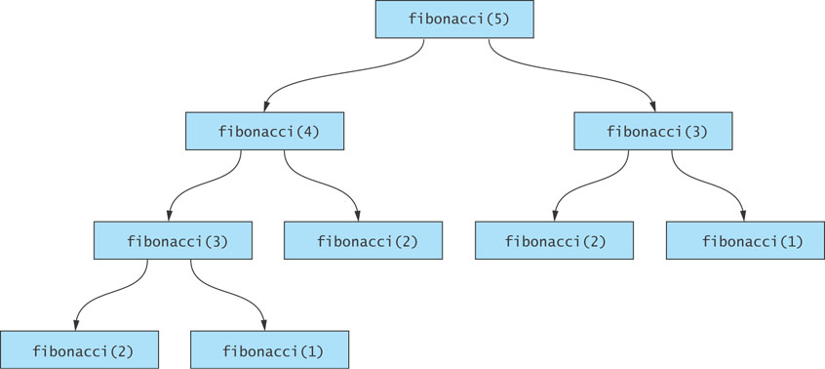
Fibonacci Numbers (cont.)
Inefficient

Slide 48
Fibonacci Numbers (cont.)

Slide 49
An O(n) Recursive fibonacci Function
/** Recursive O(n) function to calculate Fibonacci numbers
pre: n >= 1
@param fib_current The current Fibonacci number
@param fib_previous The previous Fibonacci number
@param n The count of Fibonacci numbers left to calculate
@return The value of the Fibonacci number calculated so far
*/
int fibo(int fib_current, int fib_previous, int n) {
if (n == 1)
return fib_current;
else
return fibo(fib_current + fib_previous, fib_current, n – 1);
}

Slide 50
An O(n) Recursive fibonacci Function (cont.)
In order to start the function executing, we provide a non-recursive wrapper function:
/** Wrapper function for calculating Fibonacci numbers
pre: n >= 1
@param n The position of the desired Fibonacci number
@return The value of the nth Fibonacci number
*/
int fibonacci_start(int n) {
return fibo(1, 0, n);
}

Slide 51
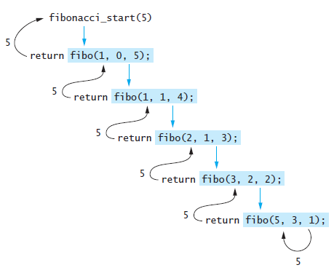
Efficiency of Recursion: O(n) fibonacci
Efficient

Slide 52
Recursive Search
Section 7.3

Slide 53
Recursive vector Search
Searching a vector can be accomplished using recursion
The simplest way to search is a linear search
Examine one element at a time starting with the first element or the last element to see whether it matches the target
On average, approximately n/2 elements are examined to find the target in a linear search
If the target is not in the vector, all n elements are examined
A linear search is O(n)

Slide 54
Design of a Recursive Linear Search Algorithm
Base cases for recursive search:
Empty vector, target can not be found; result is -1
First element of the vector matches the target; result is the subscript of first element
The recursive step searches the rest of the vector, excluding the first element

Slide 55
Algorithm for Recursive Linear vector Search
if the vector is empty
The result is –1
else if the first element matches the target
The result is the subscript of the first element
else
Search the vector excluding the first element and return the result

Slide 56
Implementation of Recursive Linear Search
/** Recursive linear search function
@param items The vector being searched
@param target The item being searched for
@param pos_first The position of the current first element
@return The subscript of target if found; otherwise -1
*/
template<typename Item_Type>
int linear_search(const std::vector<Item_Type>& items,
const Item_Type& target, size_t pos_first) {
if (pos_first == items.size())
return -1;
else if (target == items[pos_first])
return pos_first;
else
return linear_search(items, target, pos_first + 1);
}

Slide 57
Implementation of Recursive Linear Search (cont.)
A non-recursive wrapper function:
/** Wrapper for recursive linear search function
@param items The vector being searched
@param target The object being searched for
@return The subscript of target if found; otherwise -1
*/
template<typename Item_Type>
int linear_search(const std::vector<Item_Type>& items,
const Item_Type& target) {
return linear_search(items, target, 0);
}

Slide 58
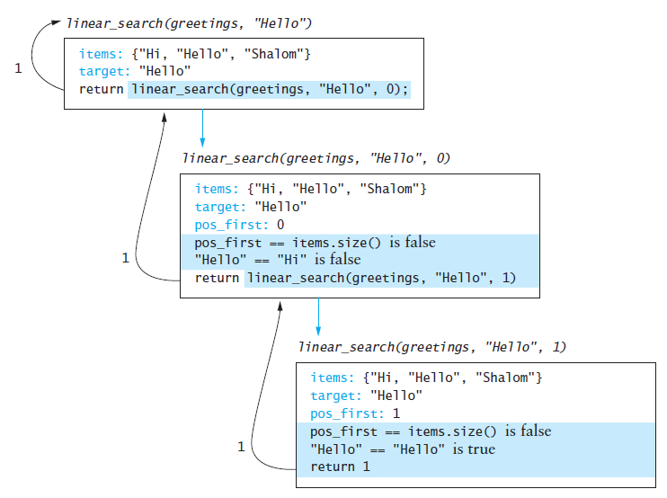
Implementation of Recursive Linear Search (cont.)

Slide 59
Design of a Binary Search Algorithm
A binary search can be performed only on an array or vector that has been sorted
Base cases
The vector is empty
The element being examined matches the target
Rather than looking at the first element, a binary search compares the middle element for a match with the target
If the middle element does not match the target, a binary search excludes the half of the vector within which the target cannot lie

Slide 60
Design of a Binary Search Algorithm (cont.)
Binary Search Algorithm
if the vector is empty
Return –1 as the search result
else if the middle element matches the target
Return the subscript of the middle element as the result
else if the target is less than the middle element
Recursively search the vector elements before the middle element and return the result
else
Recursively search the vector elements after the middle element and return the result

Slide 61
Binary Search Algorithm
Caryn
Debbie
Dustin
Elliot
Jacquie
Jonathon
Rich
first = 0
middle = 3
last = 6

Slide 62
Binary Search Algorithm (cont.)
Caryn
Debbie
Dustin
Elliot
Jacquie
Jonathon
Rich
first = 0
last = 2

Slide 63
Binary Search Algorithm (cont.)
Caryn
Debbie
Dustin
Elliot
Jacquie
Jonathon
Rich
first= middle = last = 2

Slide 64
Efficiency of Binary Search
At each recursive call we eliminate half the vector elements from consideration, making a binary search O(log n)
A vector of size16 would search vectors of length 16, 8, 4, 2, and 1, making 5 probes in the worst case
16 = 2⁴
5 = log₂16 + 1
A doubled vector size would require only 6 probes in the worst case
32 = 2⁵
6 = log₂32 + 1
A vector with 32,768 elements requires only 16 probes! (log₂32,768 = 15); a vector of 65,536 elements increases the number of required probes to 17

Slide 65
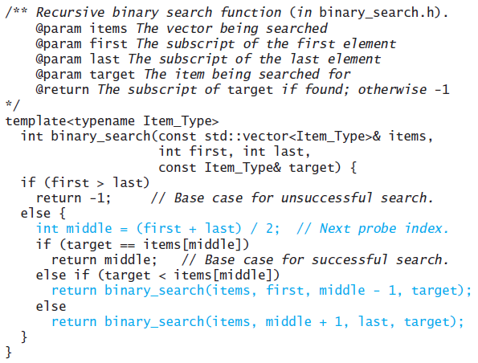
Implementation of a Binary Search Algorithm

Slide 66
Implementation of a Binary Search Algorithm

Slide 67
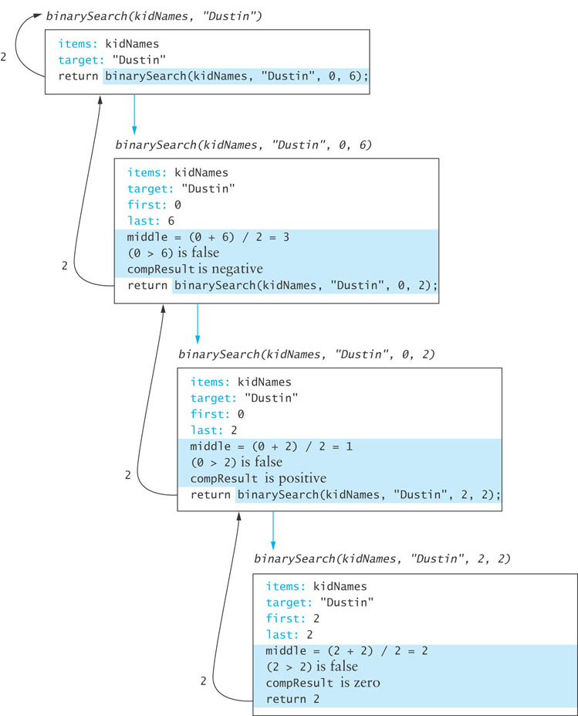
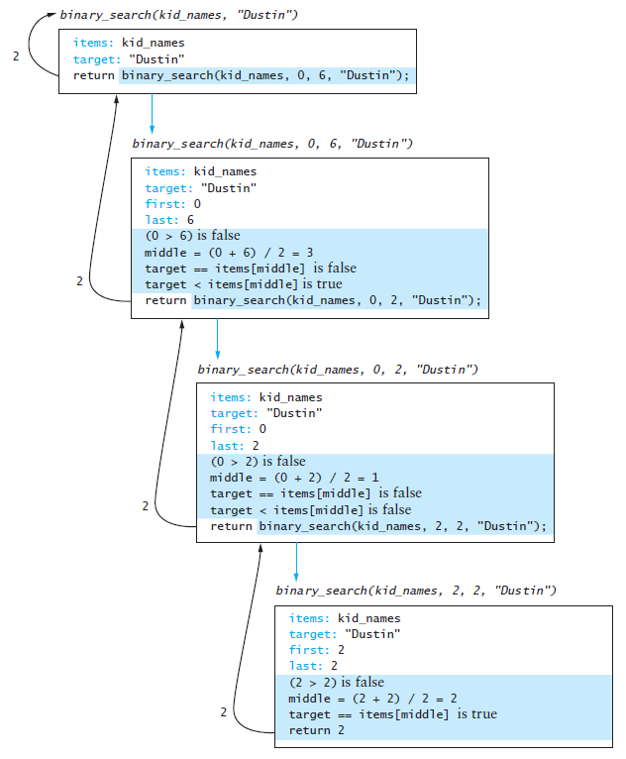
Trace of Binary Search

Slide 68
Testing Binary Search
You should test vectors with
an even number of elements
an odd number of elements
duplicate elements
Test each vector for the following cases:
the target is the element at each position of the vector, starting with the first position and ending with the last position
the target is less than the smallest vector element
the target is greater than the largest vector element
the target is a value between each pair of items in the vector

Slide 69
Problem Solving with Recursion
Section 7.4

Slide 70
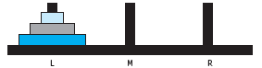
Towers of Hanoi
Move the three disks to a different peg, maintaining their order (largest disk on bottom, smallest on top, etc.)
Only the top disk on a peg can be moved to another peg
A larger disk cannot be placed on top of a smaller disk

Slide 71
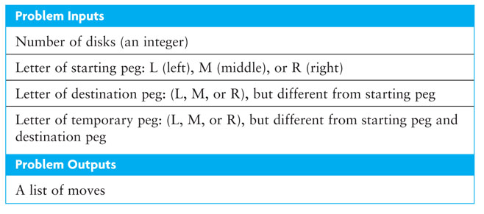
Problem Inputs and Outputs

Slide 72
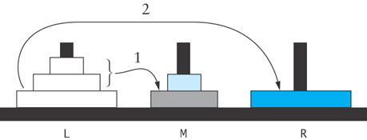
Design
Solution to 3-Disk Problem: Move 3 Disks from Peg L to Peg R
1. Move the top two disks from peg L to peg M.
2. Move the bottom disk from peg L to peg R.
3. Move the top two disks from peg M to peg R.

Slide 73
Design (cont.)
Solution to 2-Disk Problem: Move Top 2 Disks from Peg M to Peg R
1. Move the top disk from peg M to peg L.
2. Move the bottom disk from peg M to peg R.
3. Move the top disk from peg L to peg R.

Slide 74
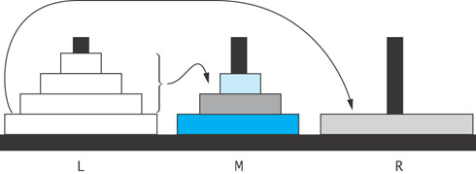
Design (cont.)
Solution to 4-Disk Problem: Move 4 Disks from Peg L to Peg R
1. Move the top three disks from peg L to peg M.
2. Move the bottom disk from peg L to peg R.
3. Move the top three disks from peg M to peg R.

Slide 75
Recursive Algorithm for Towers of Hanoi
Recursive Algorithm for n-Disk Problem: Move n Disks from the Starting Peg to the Destination Peg
if n is 1
Move disk 1 (the smallest disk) from the starting peg to the destination peg
else
Move the top n – 1 disks from the starting peg to the temporary peg (neither starting nor destination peg)
Move disk n (the disk at the bottom) from the starting peg to the destination peg
Move the top n – 1 disks from the temporary peg to the destination peg

Slide 76
Recursive Algorithm for Towers of Hanoi (cont.)
Our recursive function, show_moves, will display the solution as a list of disk moves
For the two-disk problem shown earlier (move two disks from the middle peg, M, to the right peg, R), the list of moves would be
Move disk 1 from peg M to peg L
Move disk 2 from peg M to peg R
Move disk 1 from peg L to peg R
The function show_moves must have the number of disks, the starting peg, the destination peg, and the temporary peg as its parameters.

Slide 77
Recursive Algorithm for Towers of Hanoi (cont.)

Slide 78
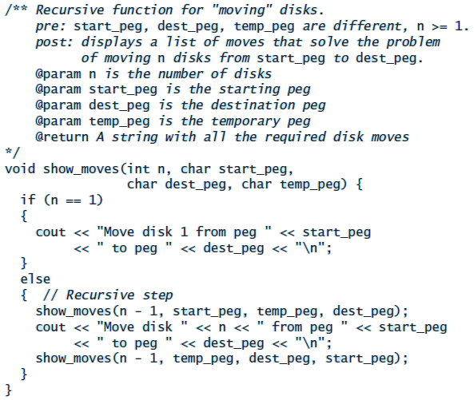
Implementation

Slide 79
Testing
int main() {
int n_disks;
char start_peg;
char dest_peg;
char temp_peg;
cout << "Enter number of disks: ";
cin >> n_disks;
cout << "Enter start peg: ";
cin >> start_peg;
cout << "Enter destination peg: ";
cin >> dest_peg;
cout << "Enter temporary peg: ";
cin >> temp_peg;
show_moves(n_disks, start_peg, dest_peg, temp_peg);
}

Slide 80
Counting Cells in a Blob
Consider how we might process an image that is presented as a two-dimensional grid of color values
Information in the image may come from
an X-ray
an MRI
satellite imagery
etc.
The goal is to determine the size of any area in the image that is considered abnormal because of its color values

Slide 81
Problem
Given a two-dimensional grid of cells, each cell contains either a normal background color or a second color, which indicates the presence of an abnormality
A blob is a collection of contiguous abnormal cells
A user will enter the x, y coordinates of a cell in the blob, and the program will determine the count of all cells in that blob

Slide 82
Analysis
Problem Inputs
The two-dimensional grid of cells
The position of a cell in a blob
Problem Outputs
The count of cells in the blob

Slide 83
Design
Algorithm for Function count_cells
if the cell at grid[r][c] is outside the grid dimensions
The result is 0
else if the color of the cell grid[r][c] is not the abnormal color
The result is 0
else
Set the color of the cell grid[r][c] to a temporary color
The result is 1 plus the number of cells in each blob that includes a nearest neighbor

Slide 84
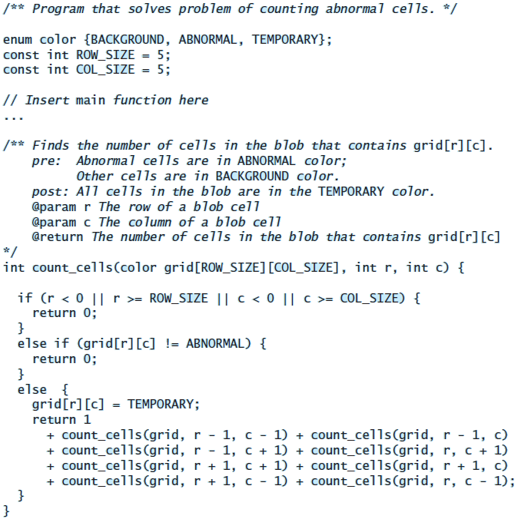
Implementation

Slide 85
Testing
#include <iostream>
int count_cells(color[ROW_SIZE][COL_SIZE], int, int);
int main() {
color grid[ROW_SIZE][COL_SIZE] =
{{BACKGROUND, ABNORMAL, BACKGROUND, ABNORMAL, ABNORMAL},
{BACKGROUND, ABNORMAL, BACKGROUND, BACKGROUND, ABNORMAL},
{BACKGROUND, BACKGROUND, BACKGROUND, ABNORMAL, BACKGROUND},
{BACKGROUND, ABNORMAL, BACKGROUND, BACKGROUND, BACKGROUND},
{BACKGROUND, ABNORMAL, BACKGROUND, ABNORMAL, BACKGROUND}};
// Enter row and column of a cell in the blob.
int row;
std::cout << "Enter row: "; std::cin >> row;
int col;
std::cout << "Enter column: "; std::cin >> col;
// Display results.
std::cout << count_cells(grid, row, col) << "\n";
}

Slide 86
Testing (cont.)
Verify that the code works for the following cases:
A starting cell that is on the edge of the grid
A starting cell that has no neighboring abnormal cells
A starting cell whose only abnormal neighbor cells are diagonally connected to it
A "bull's-eye": a starting cell whose neighbors are all normal but their neighbors are abnormal
A starting cell that is normal
A grid that contains all abnormal cells
A grid that contains all normal cells

Slide 87
Backtracking
Section 7.5

Slide 88
Backtracking
Backtracking is an approach to implementing a systematic trial and error search for a solution
An example is finding a path through a maze
If you are attempting to walk through a maze, you will probably walk down a path as far as you can go
Eventually, you will reach your destination and exit the maze or you won’t be able to go any farther
If you can’t go any farther, you will need to consider alternative paths—you will need to backtrack until you reach a fork and follow a branch you did not travel hoping to reach your destination
Backtracking is a systematic, nonrepetitive approach to trying alternative paths and eliminating them if they don’t work

Slide 89
Backtracking (cont.)
If you never try the same path more than once, you will eventually find a solution path if one exists
Problems that are solved by backtracking can be described as a set of choices made by some function
Recursion allows you to implement backtracking in a relatively straightforward manner
Each activation frame is used to remember the choice that was made at that particular decision point
A program that plays chess may involve some kind of backtracking algorithm

Slide 90
Finding a Path through a Maze
Problem
Use backtracking to find and display the path through a maze
From each point in a maze you can move to the next cell in a horizontal or vertical direction if the cell is not blocked

Slide 91
Analysis
The maze will consist of a grid of cells
The starting point is at the top left corner grid[0][0]
The exit point is at the bottom right corner (grid[ROW_SIZE - 1][COL_SIZE - 1])
All cells on the path will be BACKGROUND color
All cells that represent barriers will be ABNORMAL color
Cells that we have visited will be TEMPORARY color
If we find a path, all cells on the path will be set to PATH color

Slide 92
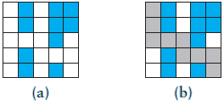
Analysis (cont.)

Slide 93
Design
Recursive Algorithm for find_maze_path(x, y)
if the current cell is outside the maze
Return false (you are out of bounds)
else if the current cell is part of the barrier or has been visited already
Return false (you are off the path or in a cycle)
else if the current cell is the maze exit
Recolor it to the path color and return true (you have successfully completed the maze)
else // Try to find a path from the current path to the exit:
Mark the current cell as on the path by recoloring it to the path color
for each neighbor of the current cell
if a path exists from the neighbor to the maze exit
Return true
// No neighbor of the current cell is on the path
Recolor the current cell to the temporary color (visited) and return false

Slide 94
Design (cont.)
There is no attempt to find the shortest path through the maze
We just show the first path that is found

Slide 95
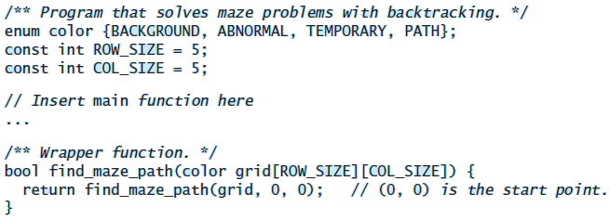
Implementation

Slide 96
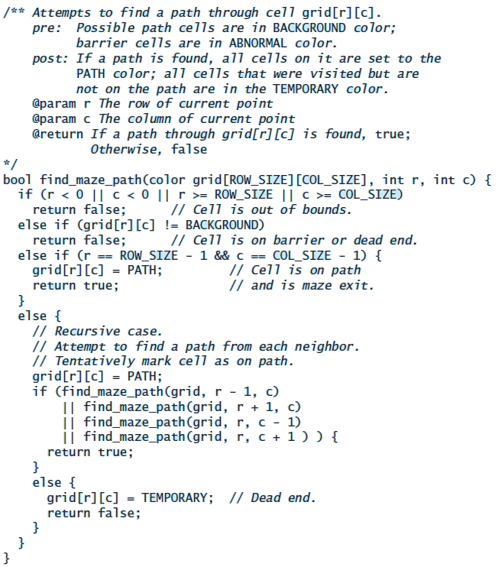
Implementation

Slide 97
The Effect of Marking a Cell as Visited
Would the program still work if instead of recoloring a “dead end” to the temporary color, we recolored it to the background color?
The answer is “Yes”
This would not affect the ability of the algorithm to find a path or to determine that none exists; however, it would affect the algorithm’s efficiency:
After backtracking, the function could try to place on the path a cell that had been found to be a dead end
The cell would be classified once again as a dead end
Marking it as a dead end (color TEMPORARY) the first time prevents this from happening

Slide 98
The Effect of Marking a Cell as Visited (cont.)
To demonstrate the efficiency of this approach, the authors tested the program on a maze with 4 rows and 6 columns that had a single barrier cell at the maze exit
When they recolored each dead end cell in the TEMPORARY color, it took 93 recursive calls to find_maze_path to determine that a path did not exist
When they recolored each tested cell in the BACKGROUND color, it took 177,313 recursive calls to determine that a path did not exist

Slide 99
Testing
#include <iostream>
bool find_maze_path(color[ROW_SIZE][COL_SIZE]);
bool find_maze_path(color[ROW_SIZE][COL_SIZE], int, int);
int main() {
color grid[ROW_SIZE][COL_SIZE] =
{{BACKGROUND, ABNORMAL, BACKGROUND, ABNORMAL, ABNORMAL},
{BACKGROUND, ABNORMAL, BACKGROUND, ABNORMAL, ABNORMAL},
{BACKGROUND, BACKGROUND, BACKGROUND, ABNORMAL, BACKGROUND},
{BACKGROUND, ABNORMAL, BACKGROUND, BACKGROUND, BACKGROUND},
{BACKGROUND, ABNORMAL, BACKGROUND, ABNORMAL, BACKGROUND}};
// Display results.
std::cout << std::boolalpha << find_maze_path(grid) << "\n";
}

Slide 100
Testing (cont.)
Test for a variety of test cases:
Mazes that can be solved
Mazes that can't be solved
A maze with no barrier cells
A maze with a single barrier cell at the exit point

